Slide 1
The dynamics of an age-structured population Question 3
Hooi Min Tan Grahn

Slide 2
The overarching scope
The overarching scope of studying the dynamics of age-structured populations, incorporating maturation, reproduction, and density-dependent mortality, lies in comprehending and predicting the fluctuations in species abundance within ecosystems.
Understanding these dynamics provides insights into population stability, resilience, and responses to environmental changes.
Specifically, the study investigates the intricate interactions between different life stages within populations, shedding light on how birth rates, death rates, and density dependence shape population growth or decline. This analysis is particularly pertinent for ecological sciences as it serves as a foundational tool for modeling and predicting the dynamics of real-world populations.

Slide 3
Specific scope and scientific impact
This study broader significance lies in its contribution to understanding how different factors, including life stage transitions and interactions like cannibalism, influence population dynamics. Its relevance to ecological sciences is in providing a framework to model, predict, and manage populations in natural ecosystems, thereby aiding conservation efforts and ecosystem management strategies.

Slide 4
Specific questions
The specific scope revolves around formulating differential equations to capture the changes in juvenile and adult populations over time, considering maturation rates, reproduction, and density-dependent mortality. Analyzing stability within the phase plane involves examining equilibrium points and isoclines, delineating regions where population growth or decline remains constant. This phase plane analysis provides a visual representation of population dynamics and stability.
Furthermore, extending the model to include cannibalism, where adults feed on juveniles, enhances the ecological relevance of the study. This extension mirrors natural behaviors observed in various animal groups, contributing to a more realistic representation of population dynamics. The analysis of cannibalism's implications on population dynamics, equilibrium points, and overall system stability offers crucial insights into the complexities of interspecies interactions and their effects on population dynamics.

Slide 5
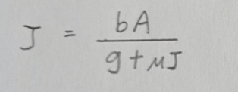
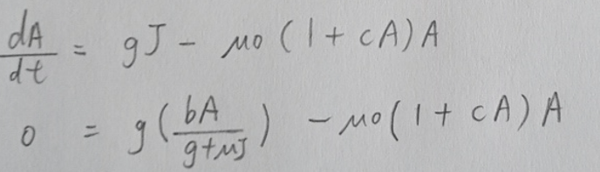
General and specific description of question 3a
I solved question 3a by solving equation dJ/dt and dA/dt mathematically by rearranging these combination of equations together. An equilibrium is defined as ‘no change’.
I solved one differential equation at a time (equal to zero).
In this case when dJ/dt = 0 and the non trivial solution for J is
When dA/dt = 0, to obtain A, I replaced the solution of J into the equation

Slide 6
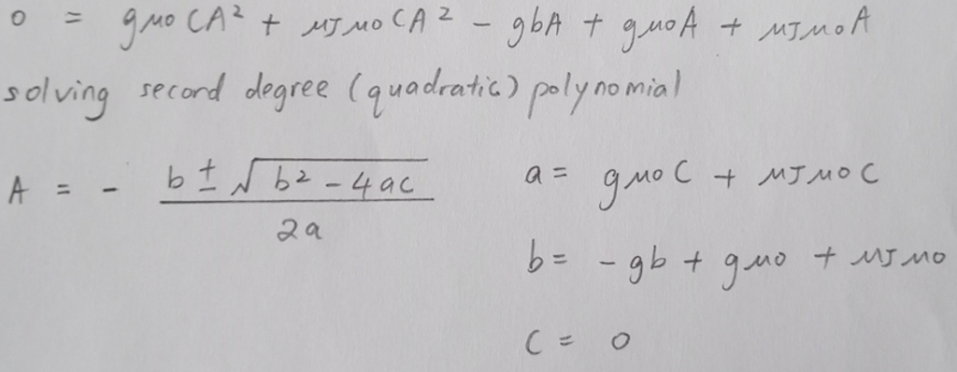
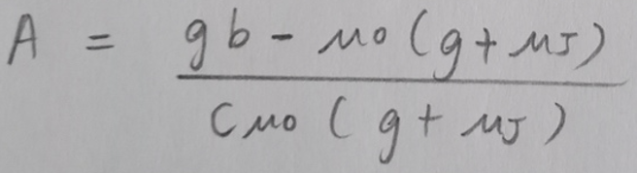
General and specific description of question 3a
I tried to solve the equation using the formula below,
The minus part = 0, the trivial solution for A is 0; while the plus part, and the non trivial solution for A is

Slide 7
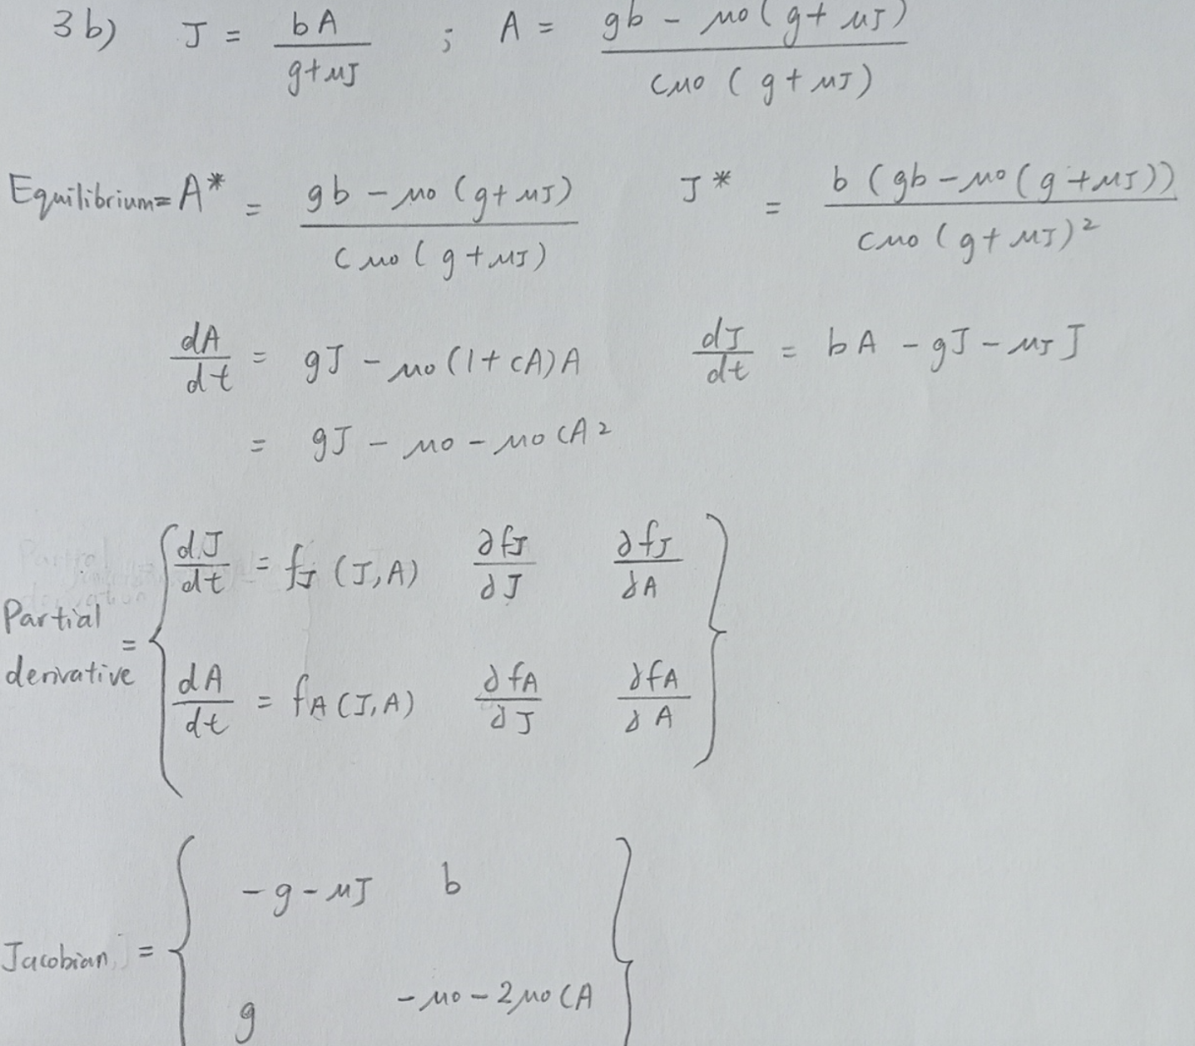
General and specific description of question 3b
I used the equilibrium value of J and A (derived from 3a). I carried out partial derivative method on differential equation of dJ/dt and dA/dt to fit the component into the Jacobian matrix.

Slide 8
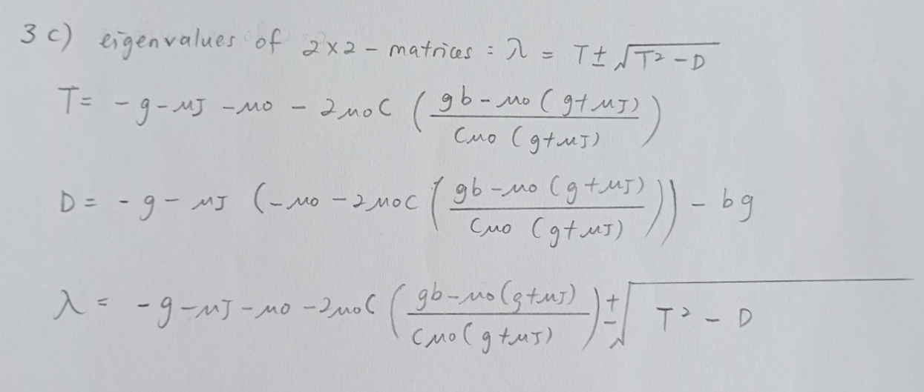
General and specific description of question 3c
To determine the stability of an equilibrium in multidimensional dynamic system, I calculate the Jacobian matrix of that equilibrium. I used the result from the Jacobian matrix (see figure from question 3b). The trace of the Jacobian (T) is negative, indicating that the sum of the diagonal elements of the matrix is negative. The determinant of the Jacobian (D) is negative, indicating the product of the diagonal elements.
The eigenvalues (λ) are negative, indicating Equilibrium A∗ and J* are stable because all eigenvalues of Jacobians have negative real part.

Slide 9
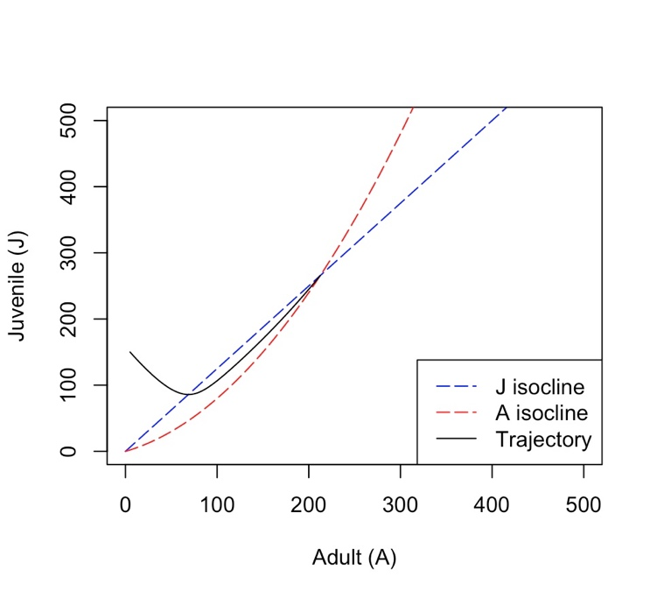
General and specific description of question 3d, 3eii
The solutions are points in phase space where the corresponding population has zero growth
Equilibrium points can be found where two isoclines of different types meet
The blue dashed line represents the J_isocline, indicating where the juvenile population remains constant concerning changes in the adult population.
The red dashed line represents the A_isocline, indicating where the adult population remains constant concerning changes in the juvenile population.
This plot helps visualize the equilibrium points and relationships between juvenile and adult populations in a given ecological or population dynamics model
ja0 <- c(j = 150, a = 5)
I imported library(deSolve) and I used ode to calculate a trajectory
Notes:
# Setting system parameters first
# Plotting J isocline as a function of A
# Plotting A isocline
# Next, use ode to calculate a trajectory
# The set of differential equations function
# set up time range
# initial values for A and J
# ode results
# Plot the result in phase space using the results data

Slide 10
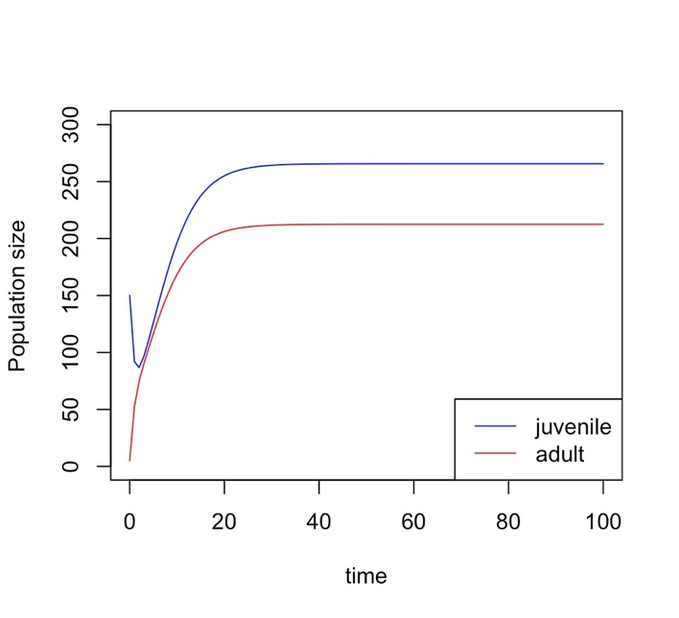
General and specific description of question 3ei
I simulated the differential equations and plots the result as A and J vs. time
There was a steep decreased of juveniles population because the initial population sizes were ja0 <- c(j = 150, a = 5)
Both populations increased further and reached equilibrium
Notes:
# set up a vector of time-points for the output
# Define parameters
# define the function JA_sys
# call the ode function to solve the differential equation
# extract the time vector
# extract the juvenile population size vector
# extract the adult population size vector
# first population sizes over time

Slide 11
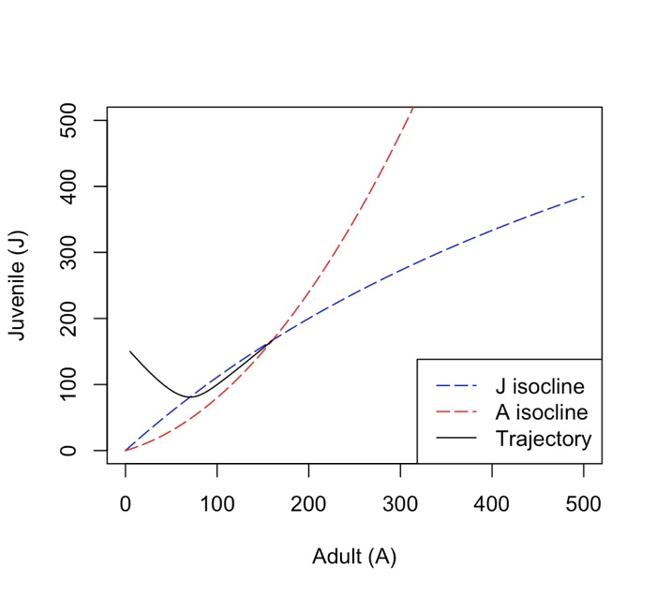
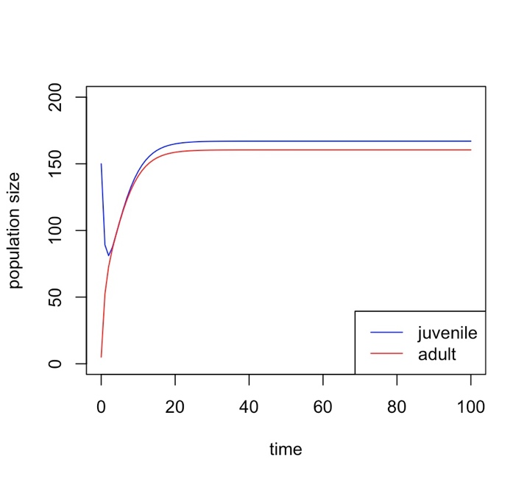
General and specific description of question 3f
I created an ode function to solve the differential equation. I added the term s.a.j is the rate at which adult predators kill juvenile and the corresponding increase of fitness of adult predators is proportional to this term by the constant gamma ε (0, 1) (Robert Marik and Lenka Pribylova, 2006).
ja0 <- c(j = 150, a = 5)
The joint equilibrium point decreased in the presence of cannibalism
Notes:
# Define system parameters first (Isocline)
# Plotting J isocline, using A as a function of J
# Plotting A isocline
# Next, use ode to calculate a trajectory
# The set of differential equations
# time range
# Adjusted initial values for A and J
# Ode results
# Plot the result in phase space using the results data
# Define the function with cannibalism (population)
JA_sys_with_cannibalism
# # Calculate the age-structured rates with cannibalism
# Define parameters including cannibalism rate
# Set initial population sizes
# Time vector
# Solve the differential equation with cannibalism
# Extract the time vector
# Extract the juvenile population size vector
# Extract the adult population size vector
# Plot the results

